Slide 1
Capstone Engagement
Assessment, Analysis, and Hardening of a Vulnerable System
Jeffery Ferris

Slide 2
Table of Contents
This document contains the following sections:
01
Network Topology
02
Red Team: Security Assessment
03
Blue Team: Log Analysis and Attack Characterization
Hardening: Proposed Alarms and Mitigation Strategies
04

Slide 3
Network Topology
‹#›

Slide 4
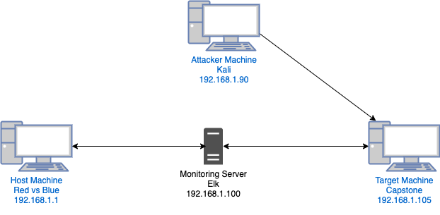
Network Topology
[Insert Here]
Use draw.io to create a diagram of the network.
Add your diagram to this slide and fill out the data in the sidebar.
Network
Address Range:192.168.1.0/24
Netmask: 255.255.255.0
Gateway:10.0.0.7
Machines
IPv4:192.168.1.90
OS:Linux
Hostname:Kali
IPv4:192.168.1.105
OS:Linux
Hostname:Capstone
IPv4:192.168.1.100
OS: Linux
Hostname:ELK
IPv4:192.168.1.1
OS:
Hostname:Red vs Blue

Slide 5

Red Team
Security Assessment
‹#›

Slide 6
Recon: Describing the Target
Nmap identified the following hosts on the network:
Hostname | IP Address | Role on Network
Red vs Blue | 192.168.1.1 | Host Machine for Red vs Blue used to view data from the ELK server
Kali | 192.168.1.90 | Attacker Machine which launched an attack against the target machine Capstone
ELK | 192.168.1.100 | A machine that monitors data from the target machine
Capstone | 192.168.1.105 | Target Machine which was victimized by the attacker machine Kali

Slide 7
Vulnerability Assessment
The assessment uncovered the following critical vulnerabilities in the target:
Vulnerability | Description | Impact
Open Ports | Open ports are running applications and/or services | An attacker can use open ports to exploit the applications or services
Brute Force | Brute force attack can be used to gain username and password information | Having username and password allows attacker to gain access to files, data, applications etc..
WedDav | Webdav is a protocol that allows remote access to create, edit or move files usually with limited firewalls | A WebDav connection can allow an attacker to upload malicious files and take control of the target machine

Slide 8
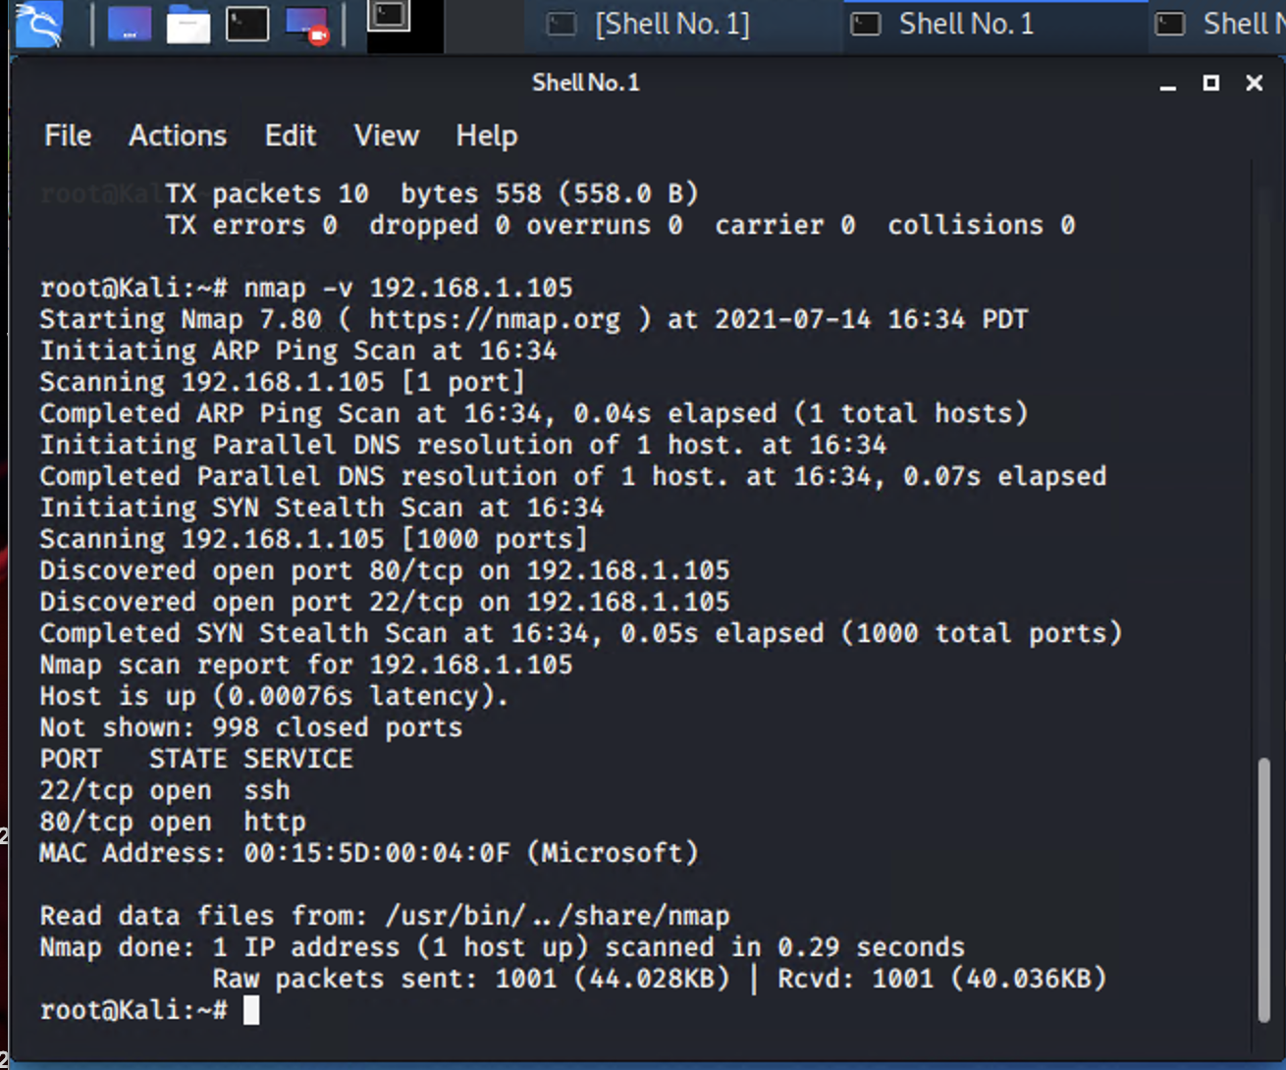
Exploitation: Open Ports
01
02
03
Tools & Processes
A nmap scan was used to determine which ports on the target machine were open
Achievements
Gained access to open ports
on the target machine by running :
nmap -v 192.168.1.105
To find port 80/tcp was open

Slide 9
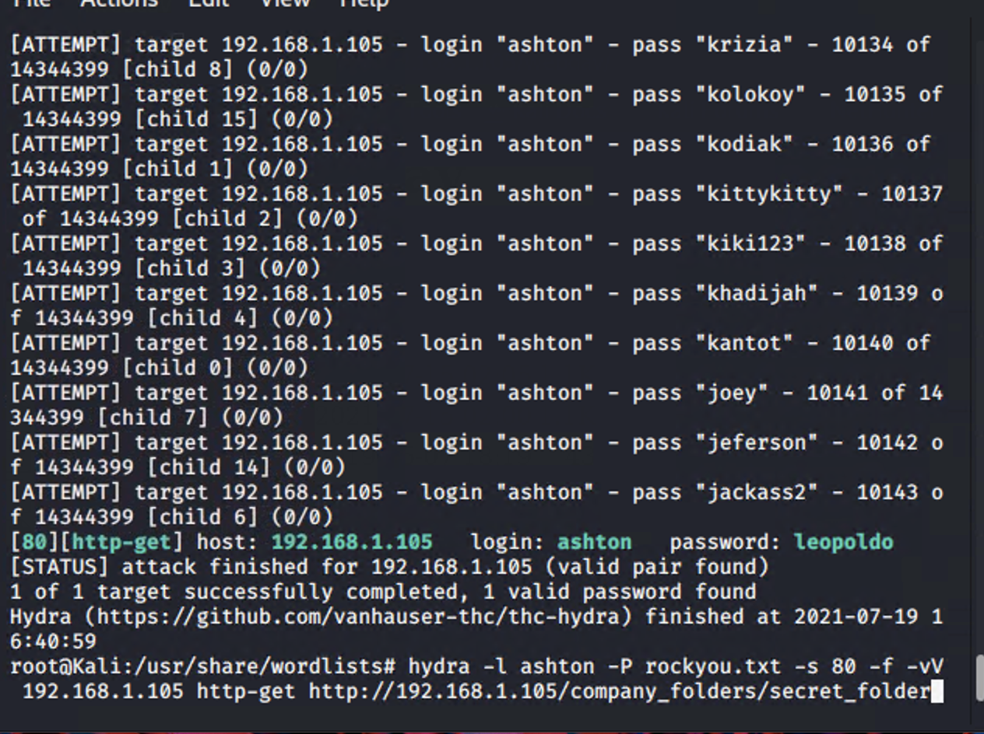
Exploitation: Brute Force
01
02
03
Tools & Processes
In the Brute Force attack utilized the hydra command that is used to crack passwords
Achievements
Utilizing hydra was able to gain access to Ashton’s password “leopoldo” on the target machine
hydra -l ashton -P rockyou.txt -s 80 -f -vV 192.168.1.105 http-get http://192.168.1.105/company_folders/secret_folder

Slide 10
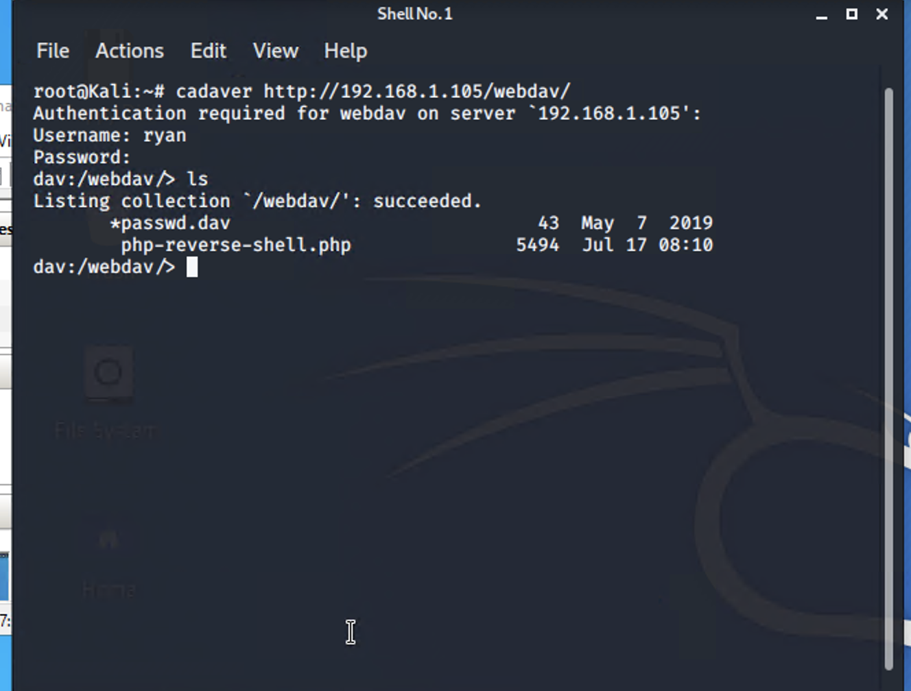
Exploitation: WebDav
01
02
03
Tools & Processes
Utilizing a browser for Capstone http://192.168.1.105:80
Determined that the target was vulnerable to WebDav access
Then utilizing cadaver command was able to gain access thru WebDav
Achievements
The exploit allowed an upload to target machine:
php-reverse-shell.php
A listening shell allowing root access to the target machine
03

Slide 11

Blue Team
Log Analysis and Attack Characterization
‹#›

Slide 12
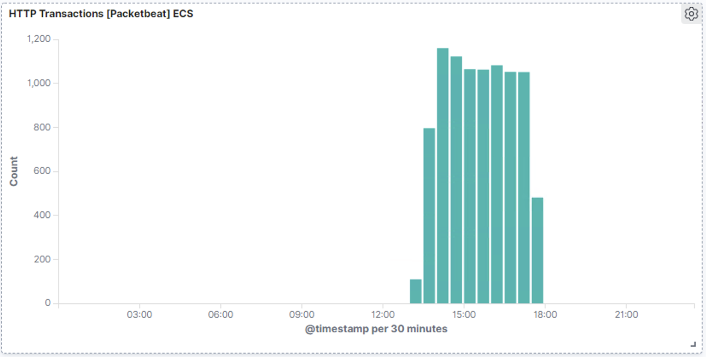
Analysis: Identifying the Port Scan
The Port Scan occurred approximately 2:00pm July 17th with 1160 packets sent from IP 192.168.1.90.
The Port Scan was is indicated by a high spike in transaction traffic.
[Insert Here]
Include a screenshot of Kibana logs depicting the port scan.

Slide 13
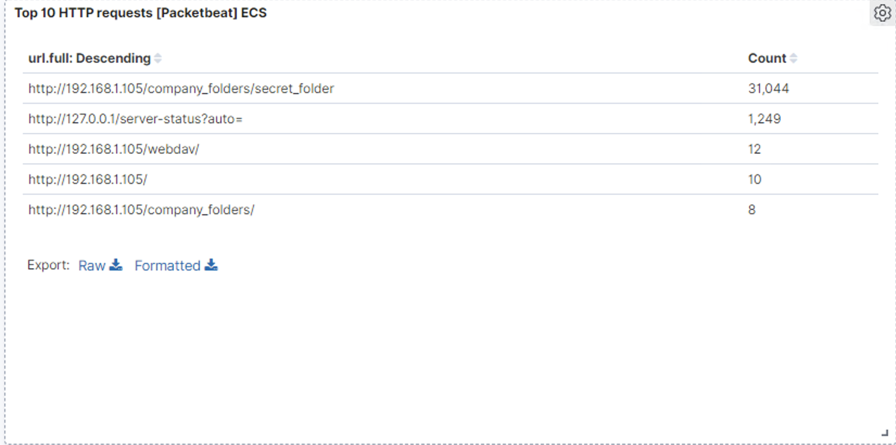
Analysis: Finding the Request for the Hidden Directory
The requests occurred from approximately from 2:00pm to 5:00pm on July 17th for a total of 31,044 requests.
The requested folder was the “secret_folder” located in the company_folder containing information about webdav.
[Insert Here]
Include a screenshot of Kibana logs depicting the request for the hidden directory.

Slide 14
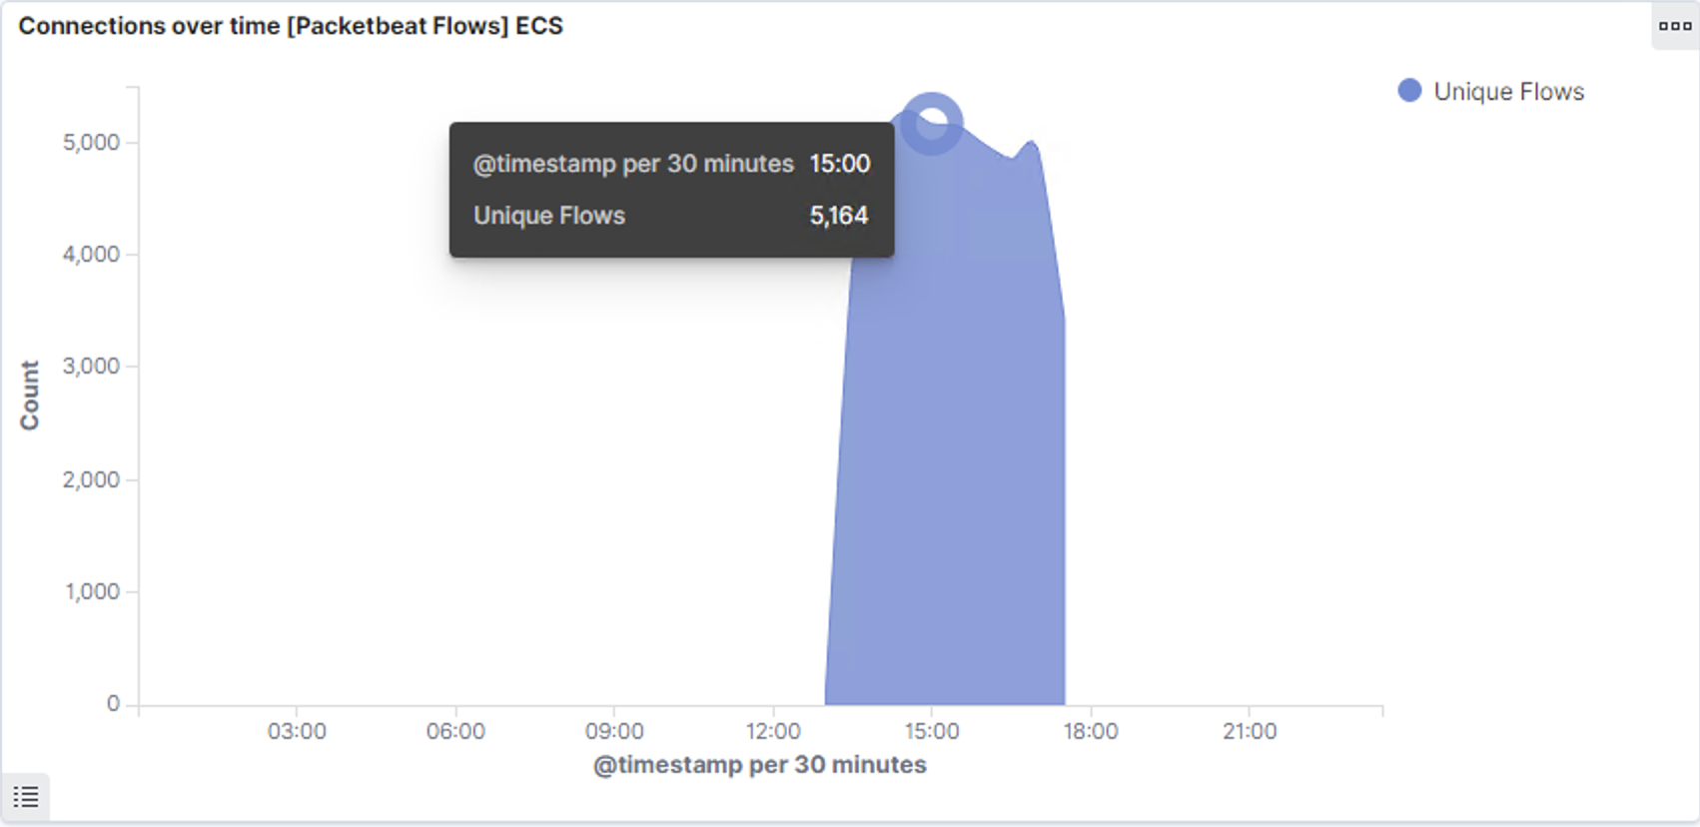
Analysis: Uncovering the Brute Force Attack
.
During the Brute Force Attack 5,164 requests were made at 3:00pm on July 17th
Discovered Hydra was the tool used in the attack with one successful attempt.
[Insert Here]
Include a screenshot of Kibana logs depicting the brute force attack.

Slide 15
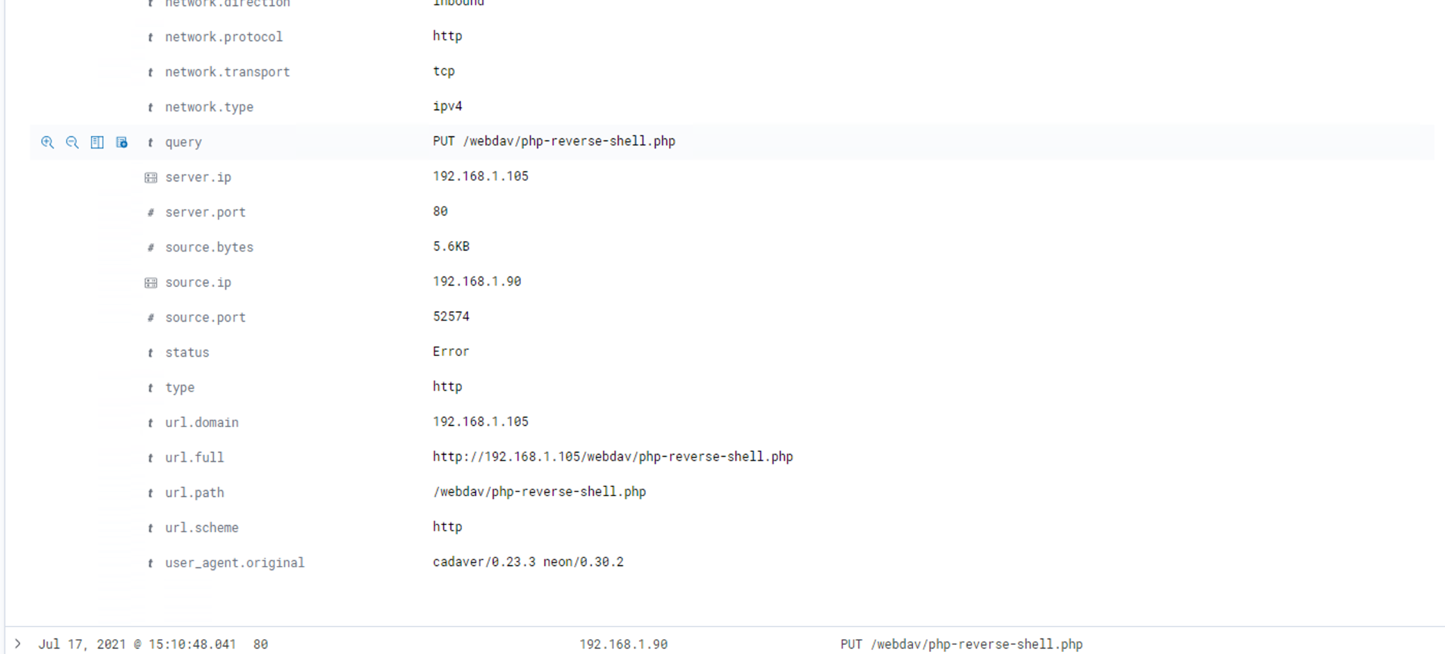
Analysis: Finding the WebDAV Connection
A total of 12 requests were made to the WebDav directory, 10 of which came back with a 200 response code. The file being requested was the php.reverse-shell.php.
[Insert Here]
Add a screenshot of Kibana logs depicting the WebDAV connection.

Slide 16
Blue Team
Proposed Alarms and Mitigation Strategies
‹#›

Slide 17
Mitigation: Blocking the Port Scan
Create a new firewall to detect port scanning that would also shut down the scan
A threshold of twice should be in place to set off the alarm
Close any ports that are not in use
Monitor all port traffic
Understand port uses and protocol
in order to put in place the appropriate
firewalls or blocks

Slide 18
Mitigation: Finding the Request for the Hidden Directory
Create an alarm for anyone that attempts to access any directories and/or files that is not an authorized user
The threshold for the alarm would be one attempt by an unauthorized user
Place additional access code or password for every single user on any directories of a high level of importance
Remove the directories if vulnerability is
to great

Slide 19
Mitigation: Preventing Brute Force Attacks
Create an alarm that would detect multiply
unsuccessful login attempts
The threshold for this alarm would be five unsuccessful login attempts
After five unsuccessful login attempts the user will be locked out
Mandate a change password order every 90 days with harder criteria

Slide 20
Mitigation: Detecting the WebDAV Connection
Create an alarm that would detect anyone trying to access the machine that is not a recognized user
The threshold for this alarm would be one attempt from unrecognized user
Install a new firewall that would only allow authorized users
Disable this service if utilization is unnecessary

Slide 21
Mitigation: Identifying Reverse Shell Uploads
Create an alarm for any directory or file trying to be uploaded to the server
The threshold for this alarm would one attempt
The alarm can also be set to have “permission requested” with an associated password
Remove the ability to upload any files from the web to this directory

